Slide 1
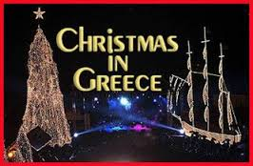
GREEK MYTHS AND RECIPES

Slide 2
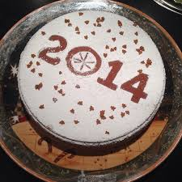
The Greek custom of Vasilopita
Vasilopita is a New Year's Day bread or cake in Greece. On New Year's Day families cut the vasilopita to bless the house and bring good luck for the new year. This is usually done at the midnight of New Year's Eve. A coin is hidden in the bread by slipping it into the dough before baking it. At midnight the sign of the cross is etched with a knife across the cake. A piece of cake is sliced for each member of the family and any visitors present at the time, by order of age from eldest to youngest. Slices are also cut for various holly people or groups of people in need, depending on local and family tradition. They may include the Lord, St. Basil and other saints, the poor, the household, or the Kallikanzaroi. In older times, the coin was often a valuable one, such as a gold sovereign. Nowadays there is often a prearranged gift, money, or something else to be given to the coin recipient.

Slide 3
The greek myth of Vasilopita and Santa Claus
During the reign of Julian the Apostate, when the Byzantine Empire declared war against Persia, Julian crossed Caesarea with his army. Then he ordered to tax the whole province and the money would be taken back to Istanbul. Thus, residents were forced to give whatever each had, gold coins etc. But Julian was ingloriously killed in a battle in the war with the Persians. Then Saint Vasilis(Santa Claus) ordered half of the taxes to be given to the poor. A small part was kept for the needs of the institution of Vasiliada(an institution which he founded to help poor people) and the rest was to be distributed to the residents: he gave an order to make bread and a coin or gold to be placed inside. Bread was distributed to the houses, so, as they were eating the bread they found something inside. This was how the custom of the pie, which is called Vasilopita, was born .

Slide 4
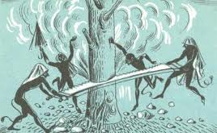
kallikanzagoi
In the myth they appear as tall, brown-skinned, with short hair and disheveled, with red eyes, monkey’s teeth, shaggy , monkey’s hands and nails , donkey’s feet, sometimes naked , sometimes ragged with hat of bristles and shoes made from iron or tsarouhia. Kallikanzagoi come from the " Underworld ", called Hades on Christmas Eve. They stay on the surface of the earth for twelve days. Besides the twelve days kallikanzagoi live in the center of the earth and saw off the tree that holds the earth. They appear on the surface we they have almost finished this job, because they are afraid that when the earth collapses they will be smashed. They disappear into the underworld, when the priests sanctify the waters the day of the Epiphany. But the tree has grown the same size as before the kallikanzaroi came to earth and they start sawing it again.

Slide 5
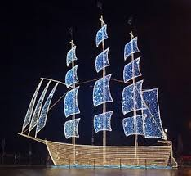
Greece was and is a naval country. For this, instead of a tree greeks decorated a boat. The greek boat is a tradition of the old times in our country which children constructed with love, joy and creative mind. However, the boat was often intertwined with the sense of separation and with unpleasant memories so it could not establish itself as a festive symbol. The first tree in Greece – probably a spruce – was decorated in 1833, in the palaces of King Othon, in Nafplion.

Slide 6
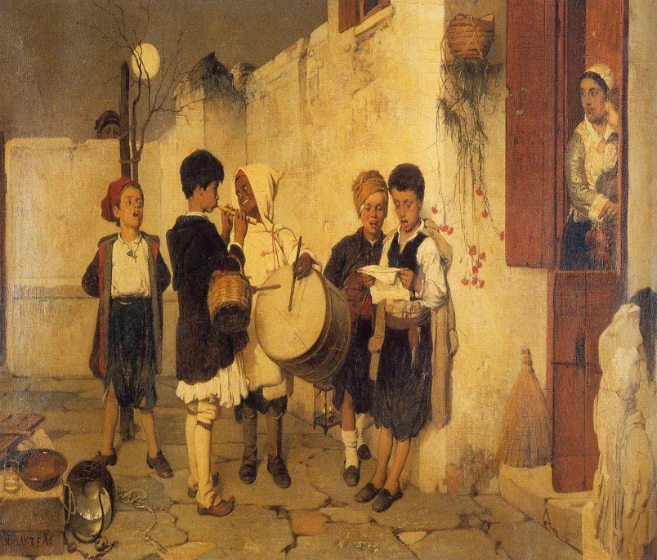
CAROLS
The Carols are a greek custom that remains undiminished even today with children going from house to house and sing carols accompanying their singing with the triangle or even guitars, accordion, lyres, and harmonicas.
Children go from door to door and ask: “Can we sing?". If the response is positive, then they sing carols for some minutes ending with the hope “We’ll see you next year. We wish you to live for many years". The reward is an amount of money, but the old days the reward was melomakarona or kourabiedes.
The Carols are chanted on the eve of major religious holidays like Christmas, New year and Epiphany.

Slide 7
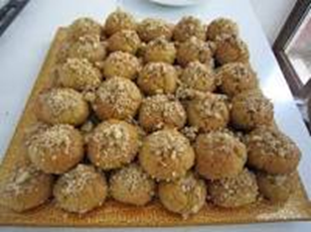
traditional sweets
Melomakarona
What we need:
• juice of two oranges
• 500 g . olive oil
• 1.200 g . flour for all purposes
• 1/2 cup sugar
• 1 tsp baking soda
1 tsp baking powder
• 1 tbsp cinnamon
• zest of 2 oranges
½ cup cognac
MATERIALS FOR SYRUP :
• 500 g . water
• 200 g . sugar
• 200 g . honey
• chopped walnuts
1.Mix the olive oil, the orange juice, and the cognac in a large bowl. In another bowl mix the flour with the sugar , the baking powder, the baking soda , the orange zest and the cinnamon . Put the two mixtures in another bowl and knead until the dough comes off your hands easily.
2.Take pieces of dough the size and shape of a walnut . Lay a grease-proof paper on a nonstick baking tray and put melomakarona there. Bake them in preheated oven at 170 ° C for 25-30 minutes.
3. Then prepare the syrup. Put the water, the sugar in o pot and boil for 7 - 8 minutes. Remove the foam from the surface and when it boils remove the pot from the heat and add the honey. Put each melomakarono into the syrup for a few seconds and then drain them and sprinkle them with chopped walnuts and cinnamon.
Try them. They are delicious!

Slide 8
Kourabiedes
500 g goat and sheep butter
150 g raw grated almonds
1 egg yolk
½ cup sugar
1 tbsp baking powder
1/2 -1 tsp vanilla powder (depending on taste)
300 g all purpose flour
For sprinkling:
icing sugar
1) Mix all the ingredients, except the flour, using a mixer until they are well mixed.
2) Continue by adding 300 g all purpose flour and mix for an additional half minute until that is well mixed.
3) Finally add 150 g raw grated almonds and mix by hand.
4) Bake in a preheated oven for 20 minutes at 175 degrees.
5) Let them cool for 10 minutes after you remove them from the oven. Be careful: if you don't let them cool for 10 minutes and you try to remove them from the baking tray they will break apart.
6) Sprinkle with icing sugar.
Best of luck!

Slide 9
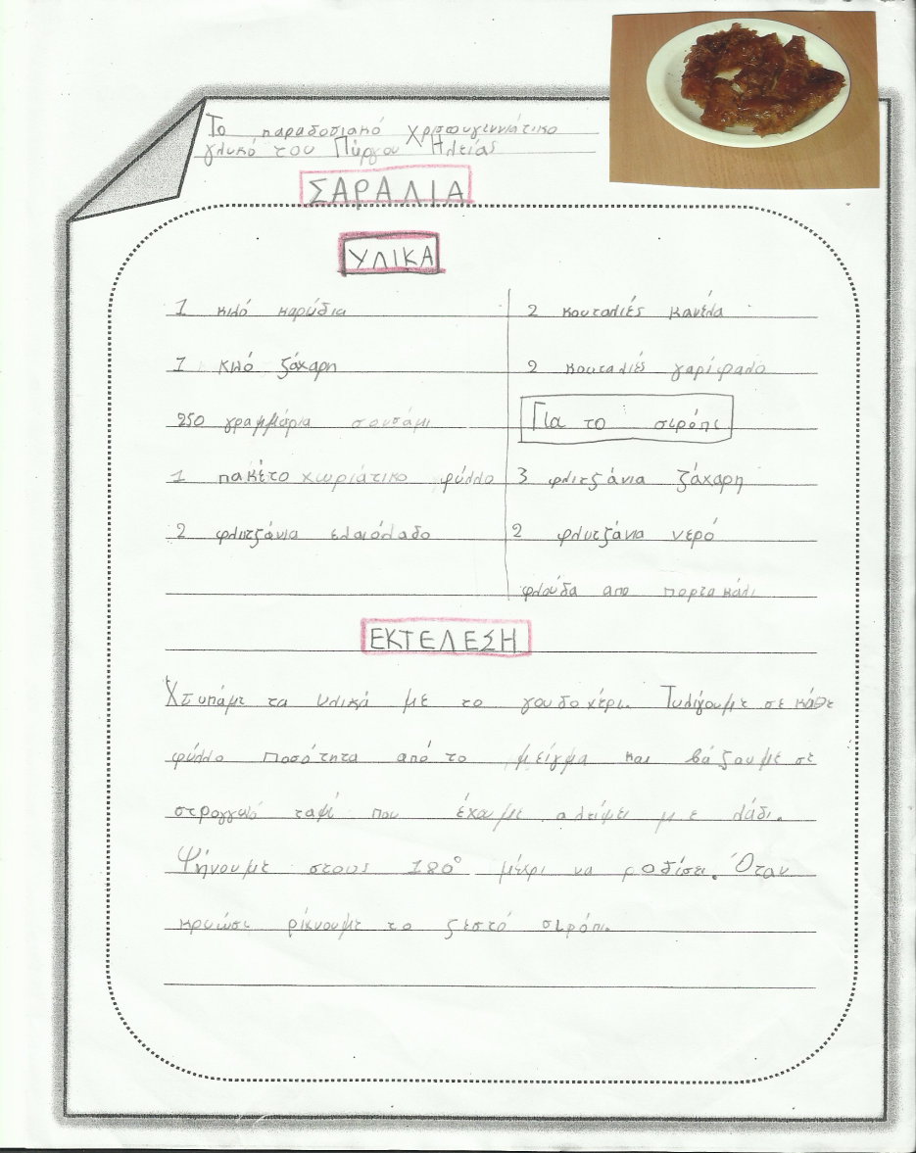
SARALIA
1kg nuts
1kg sugar
250gr sesame
2 cups olive oil
2 tsp ground cinnamon
2 tbs ground cloves
1x270g packets (12 sheets) of filo pastry
SYRUP
3 cups sugar
2 cups water
2 strips of orange zest
Cut the nuts in a food processor.Mix all the materials in the mixer. Lightly grease a 40 x 25cm shallow tin with the melted butter (using a pastry brush if you have one). Gently unfold the pastry and cover with a damp tea towel to stop it from cracking. Put a spoon of the mixture in every sheet. Roll it up into a spiral. Bake it in the oven for 25 minutes to180ºC until its colour its gets golden. When it is cold we pour the hot syrup and ….good appetite!!!

Slide 10
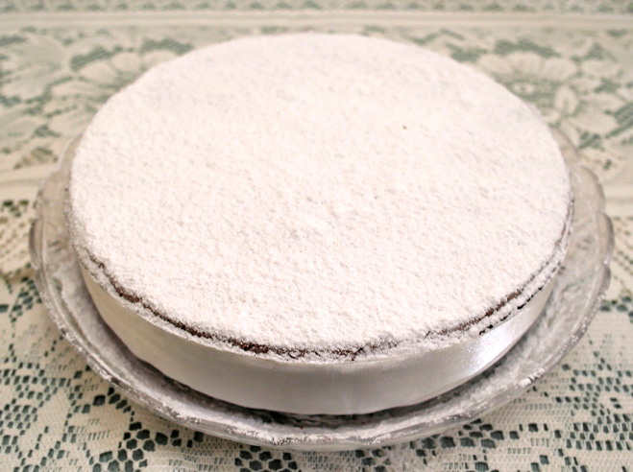
Vasilopita
3/4 cup of butter
1 1/2 cups of sugar
6 eggs
grated peel of 2 oranges
4 cups of self-rising flour
3/4 cup of milk
1 coin wrapped in foil
1 tablespoon orange zest
1 teaspoon vanilla
Preheat the oven at about 175 degrees Celsius.
2. Line the base of a 9-10 inch springform pan with wax paper and put melted butter on the sides.(You can use an even wider pan for a thinner cake-it will take less time to bake)
3. In a bowl, mix the sugar and butter until it becomes like a cream.
4. Add vanilla and orange zest- mix in a mixer for about 2 minutes.
5. Mix the eggs in a small bowl and add the butter to the mixture and mix for another 2 minutes.
6. Add the flour to the liquid ingredients and mix for 2 minutes. If you wand to put the coin in the butter, put it now.
7. Pour butter (it will be thick) in the pan, smoothing the top with a spatula.
8. Bake for about 45-60 minutes. Check with a thin sharp knife in the center, it should come out clean.
9. Remove from the oven and let cool.
10. Release the pan and turn the cake upside-down on another plate. If you want to put the coin in now, wrap in foil and push it through the cake. Turn the cake back on top and sprinkle with powdered sugar. You can make a design using paper cut outs or using almonds or raisins or you can ice the cake with a simple icing made with powdered sugar and water. Make sure you have a reward for the person who will get the coin in his piece..

